Slide 1
WEEK 9 CHECKOFF
GROUP 03-2

Slide 2
GAME IDEAS

Slide 3
FIRST IDEA: DIGISTICKS
A digital variant of Chopsticks.

Slide 4
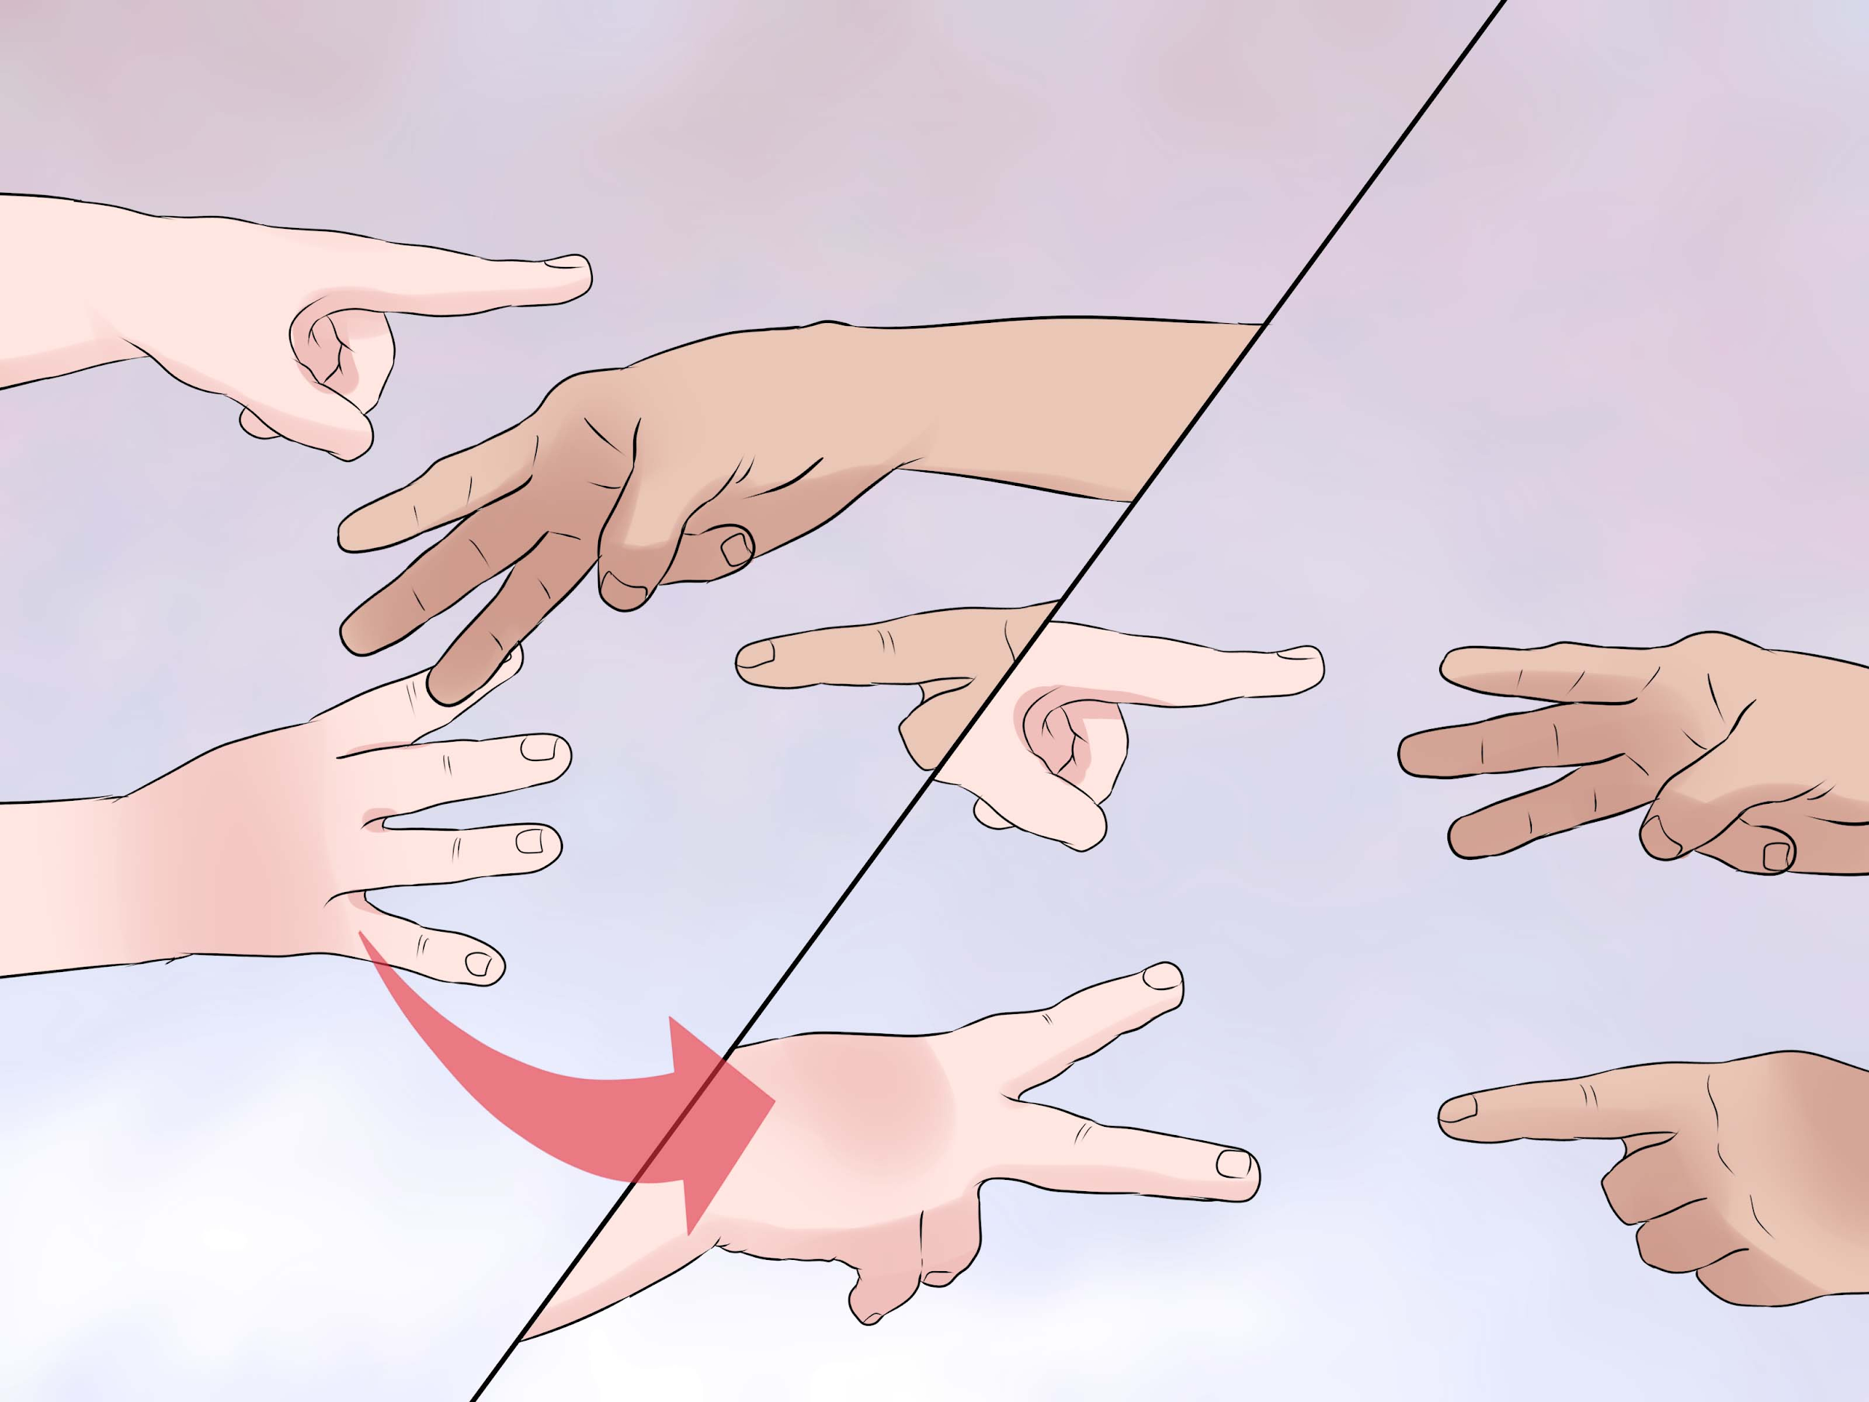
FIRST IDEA: DIGISTICKS
Our variant of the two-player Chopsticks hand game. Points in our game refer to fingers.
Rules: Each player will start with two hands, each with one point.
During each turn, each player can attack or split.
Base-5 game, therefore a roll-over amount of 5 for each hand.
Attack: Each hand can add to another hand (either one of the opponent's hand).There are also power ups available in our game, see next slide.
Split: Redistributes points between the own player’s hand, see next slide.
Hand that reaches 5 points is killed, and goes back to 0 points. The player can split the remaining points on his other hand, reviving the killed hand.
How to win: The first player with both of their hands killed (zero value) loses, while the remaining player wins.

Slide 5
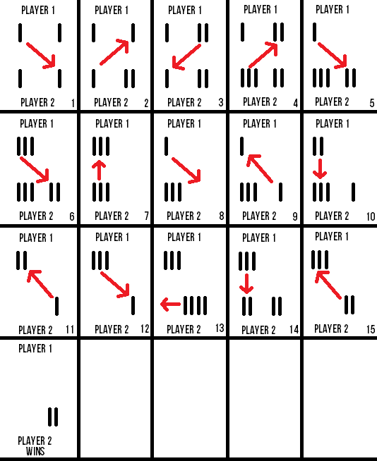
FIRST IDEA: DIGISTICKS
See a sample game play on the right.
We will be following this same system, but with additional power ups.
NORMAL ATTACK: addition + modulo
SPLIT:
if (0,2) -> (1,1)
if (0,3) -> (1,2) or (2,1)
if (0,4) -> (2,2) or (1,3) or (3,1) or (4,0)
ATTACK WITH POWERUPS:
AND
NAND
OR
NOR
XOR
XNOR
X
NOT ‘X’
NOT ‘Y’

Slide 6
FIRST IDEA: DIGISTICKS
Other considerations we made for a change in the rules.
We considered fundamentally changing the game by changing the default operation from adding to an alternative operator to make the game more unique. Instead of adding and modulo if it requires a roll over, we considered performing multiplication or division. However, they were all inappropriate as it would result in a infinite game.
Players can choose a powerup choice between 1 to 9, and implement it, replacing the addition and modulo operations for that turn. This can be done at most 3 times per player during the gameplay.

Slide 7
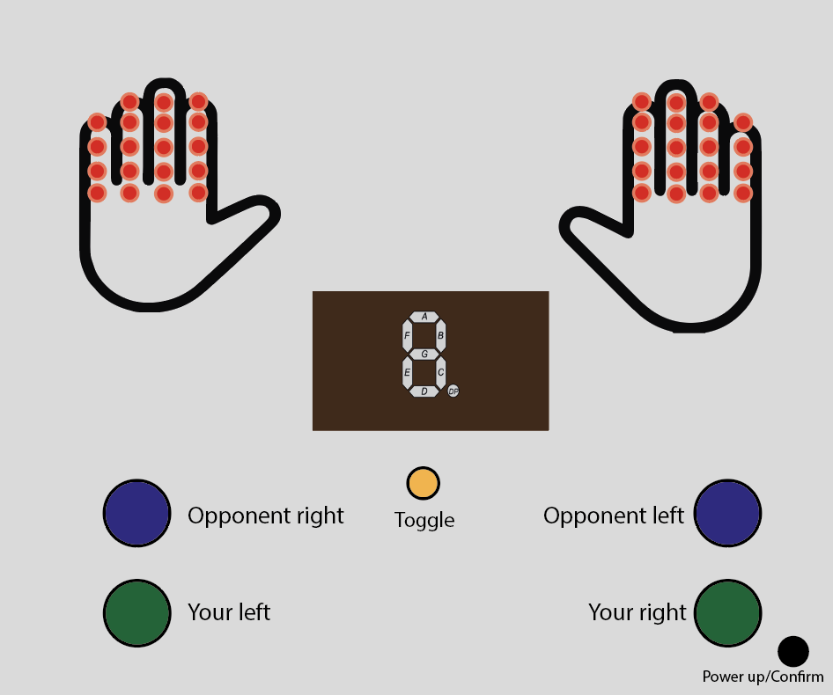
USER INTERFACE
Our game controls are simple.
The LEDs on each hand will indicate how many fingers are ‘out’.
If the fingers are not ‘out’ their LEDs will be turned off.
For you to use your right hand to perform an attack on your opponent's right hand (an addition) you simply need to press the “Your right” green button followed by the “Opponent right” blue button.
To split a hand, press the “Your right/left” button followed by “Your left/right” button to transfer fingers from your right/left hand to your left/right hand respectively. Choose the number of fingers to transfer using the “Toggle” button and confirm using the “powerup” button.
To use a powerup, simply press the “powerup” button at the start of your turn. Choose the powerup you want using the “Toggle” button and confirm using the “powerup” button. Then choose one of your hands first, and one of the opponent’s hands second to use the powerup on the opponent’s hand.

Slide 8
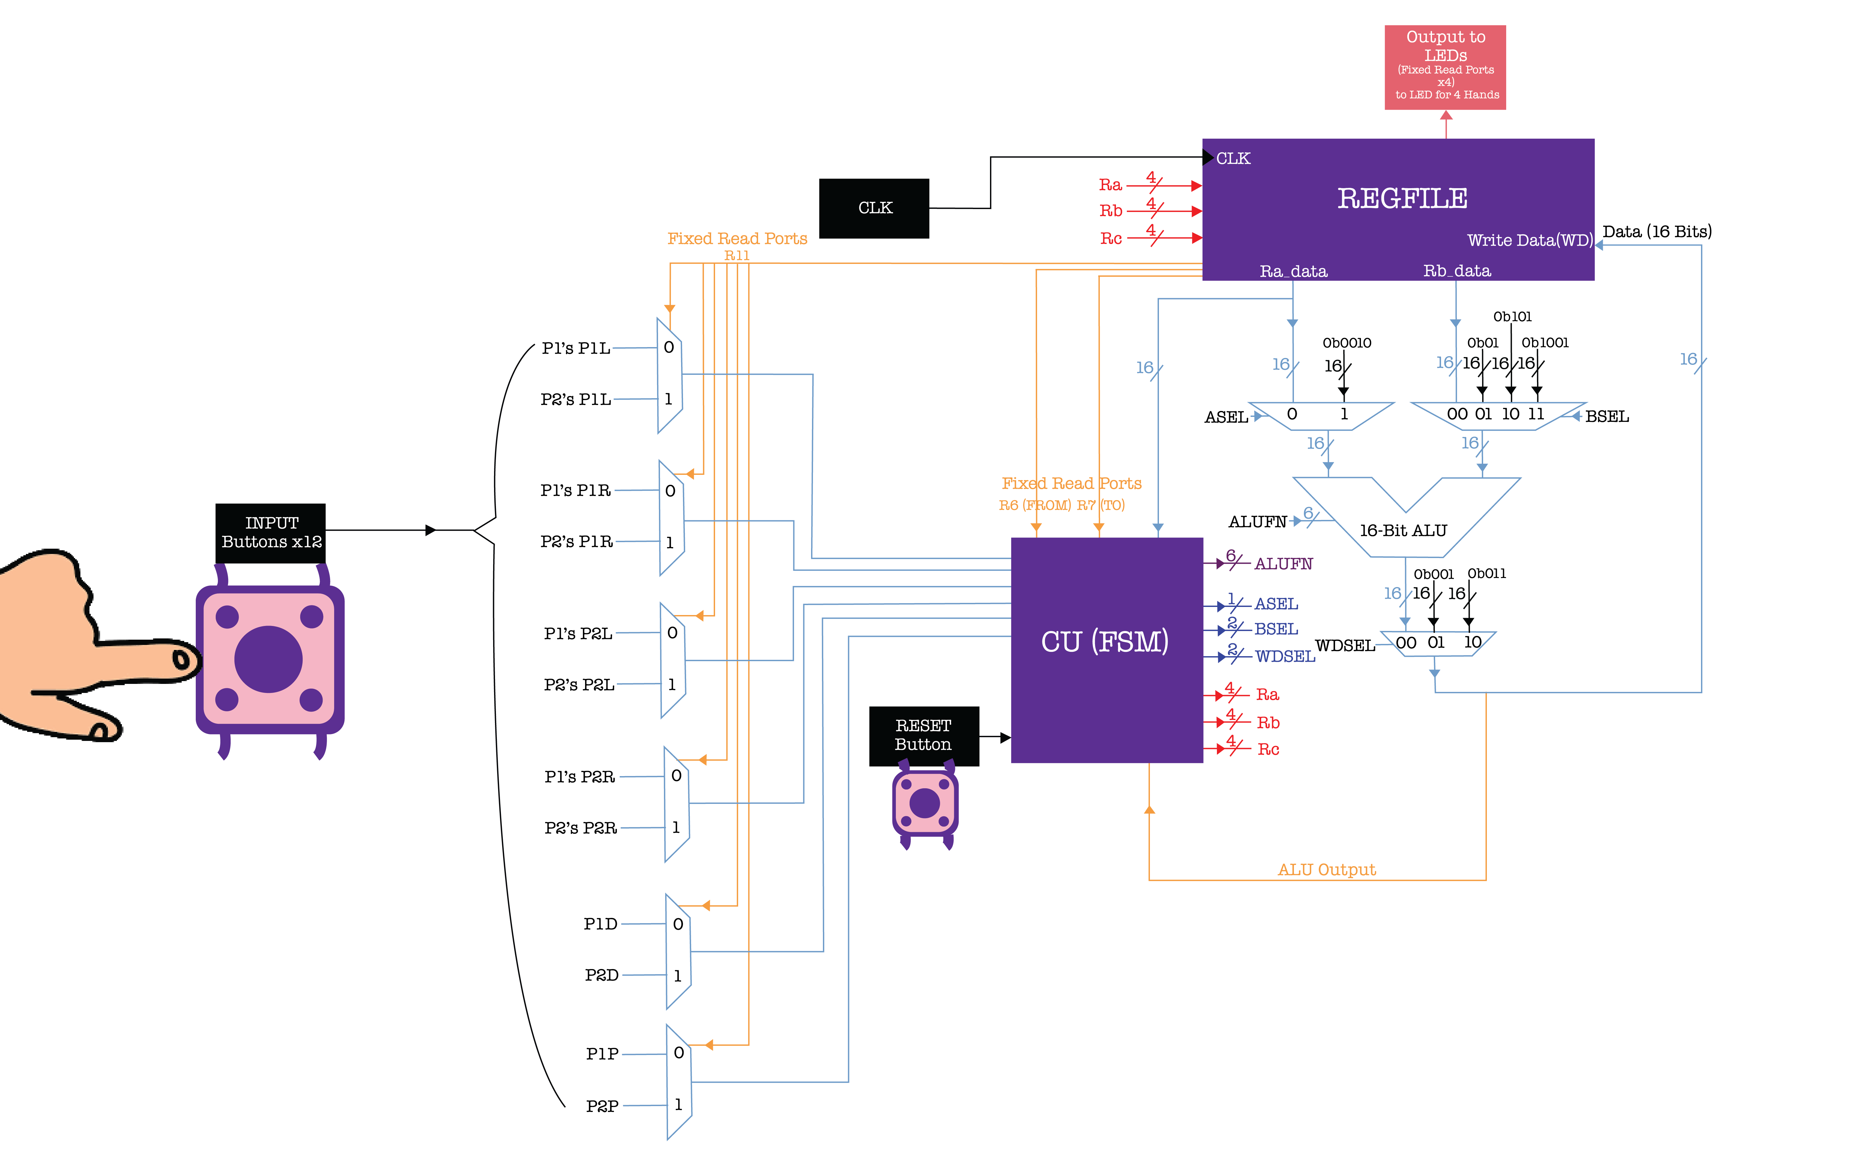
GAME’S DATAPATH

Slide 9
GAME’S FINITE STATE MACHINE DIAGRAM

Slide 10
SECOND IDEA: MORRA
Another traditional hand game played with 2 or more players.

Slide 11
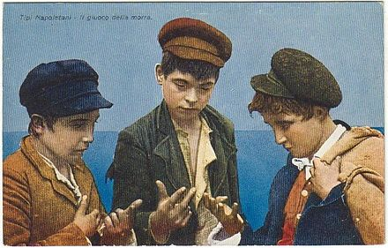
SECOND IDEA: MORRA
This game would require one hand per player and a minimum of 2 players.
Each player must reveal their hands, holding out a certain amount of fingers, from zero to five.
At the same time, they call out their guess of what the total number of fingers is.
Whoever guesses correctly wins a point.
We can implement Morra with a board of 2 or more player controls. Each player control would require an input of 5 buttons to represent their fingers, 0 to 5. And a button to increment their own points if they get the guess of the total count correctly.
This game however, will not require much arithmetic or logic for the gameplay, hence not as suitable compared to Chopsticks.

Slide 12
THIRD GAME: BISHI BASHI
A series of Konami arcade mini games.

Slide 13
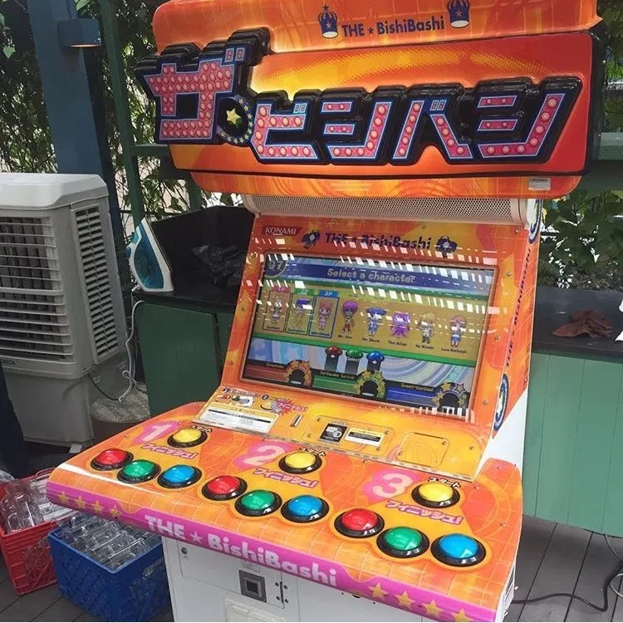
THIRD IDEA: BISHI BASHI
Each player has a red, green and blue button, positioned left, centre and right respectively.
There would be a series of minigames where each game would explain what each colored button is used for before the game commences.
For the scope of this project, we were considering the implementation of one of the minigames. We will replace the screen with a LED matrix for simple graphical representation of objects.
On the next slide, we explain the mechanics and rules of some possible minigames we were considering.

Slide 14
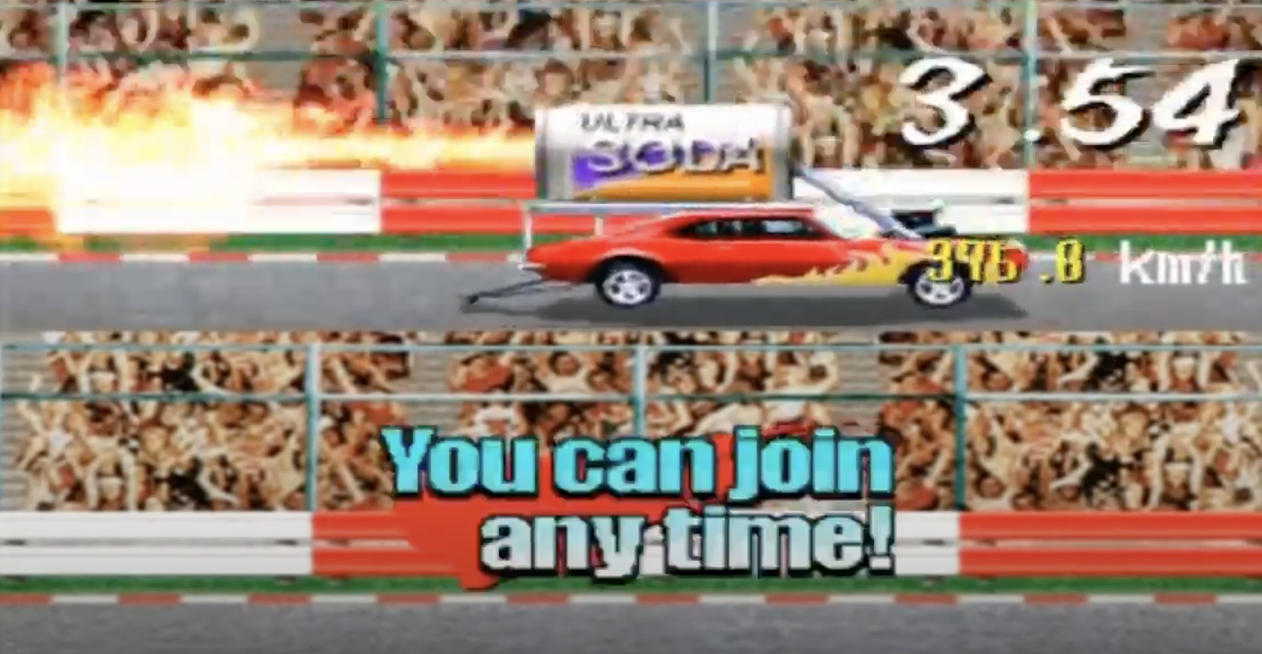
THIRD IDEA: BISHI BASHI
Example Minigame 1: Blaster Soda Race
Press red and blue button consecutively over and over again to rev up the speed of the racing car to reach the finishing time. The final score will be determined on how fast the player managed to get the car across the finish line. We can LEDs to indicate progress of the car and finish line.
Example Minigame 2: Burst the Balloon
Bash all buttons over and over, as fast as possible to burst the balloon in the time allocated. We can illustrate the balloons using LEDs with 2 different colors, green for unbust and red for burst.
One weakness of the Bishi Bashi games is that it is more challenging to implement math and logic into the game mechanics compared to Chopsticks.
Bishi Bashi is also very graphic intensive that contributes to the experience, however, with LEDs, the game may not be very aesthetically pleasing either.

Slide 15
OTHER IDEAS WE CONSIDERED
We considered implementing various card games, such as Slapjack or Ninety-Nine. However, after consultation with Prof Nat, we realised that the number of states required would unfortunately be very large and not feasible for the scope and timeline of this project.

Slide 16
END

